Slide 1

Narrated PowerPoint
Katie Ierardi

Slide 2
Point #1
Little wording

Slide 3
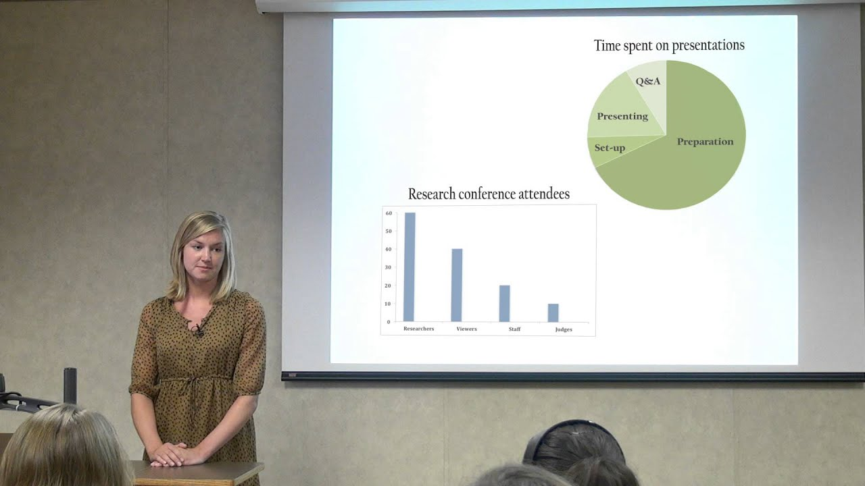
Point #2

Slide 4
Point #3
Color/Theme

Slide 5
Point #4
Size/Font

Slide 6

Thanks for watching!

